Slide 1
The aims of the shaytaan
To get the slave involved in disbelief
“I have created my servants with a natural inclination toward My worship but the Devils turn them away from the right religion and he makes the things that are unlawful to be
lawful and he orders them to make partners with Me although they have no authority to do so.”

Slide 2
2- He leads them to sins
إنَّمَّا يَأمُرُكُمْ بالسُّوءِ والْفَحْشاءِ وأَن تَقُولُوا عَلَى اللهِ ما لا تَعْلَمُونَ
He enjoins upon you only the evil and the foul, and that you should say concerning Allah that which you know not

Slide 3
3. Blocking the slave from obeying Allah p 86
4. Ruining the Acts of worship
A companion came to the Prophet (peace be on him) and said, Verily Satan comes between me and my prayer and my recitation of the Quran and confuses me. The Prophet (peace be upon him) said:
“That is a devil called khinzah. If you feel that occurring to you, seek refuge in Allah from him and spit (or blow) on your left side three times.”
The companion said he did so and Allah took that devil away from him. (Muslim)

Slide 4
5. Psychologically and physically harming
a. Attacking Human
He attacked the Prophet by trying to throw a flame of fire into his face
b-The dreams from Satan to molest and distress human
”If one of you sees a dream that he likes, it is from Allaah. He should praise Allah for it and he should relate it to others. If he sees what he dislikes, it is from Satan. He should seek refuge in Allah from it and not mention it to anyone. Thereby, it will not harm him”( Bukhary)

Slide 5
C- Burning out houses
”When you sleep at night, extinguish your lamps for Satan guides one like this (mouse) to one like this (lamp) and they burn your place down.” Abu Dawood
d. Satan fights and plays with the human at the time of death
“I seek refuge in You from the devil harming me at the time of my death”
e- Harming the child at the time of its birth
There is no one born among the offspring of Adam except that Satan touches it, so the child cries loudly at birth of his touch except Mary and her child. (Bukhaary)
Why?

Slide 6
“And I seek refuge with You (Allaah) for her and for her offspring from Shaytaan, the outcast”
The Du3aa’ of her mother

Slide 7
f. Plague is from the jinn
“Plague is the piercing of your enemies from among the jinn. And for you it is martyrdom”.
g. Various other diseases
The Prophet (peace be upon him) said, concerning the prolonged flow of blood that occurs to some women, “It is but a kick from the kicks of Satan”
h. They share in the food, drink and lodging of the humans
“Satan is permitted that food which has not had the name of Allah pronounced over it.”
“Whoever eats with his left hand, Satan eats with him. Whoever drinks with his left hand, Satan drinks with him”

Slide 8
i- The touch of Satan upon the humans (possession by jinn)
 الَّذِينَ يأكُلونَ الرِّبا لا يَقُومُونَ إلا كَما يَقُومُ الذِي يَتَخَبَّطُهُ الشَّيْطَانُ مِنَ الْمَسِّ
“Those who swallow usury cannot rise up except as he arises whom the devil has prostrated by his touch.”
Ibn Taimiya said: “None of the leaders of the Muslims reject the notion that the jinn enters into the body of the possessed”

Slide 9
The causes of being possessed by jinn
Possession of the human by the jinn can occur from desires, lusts, passions and zealousness in the same way that a human is in accord with another human.
In the majority case, due to hatred and revenge if one of the humans harms a jinn or the jinn thinks that the human was trying to harm them by urinating on some jinn or throwing hot water on them or a human might kill a jinn, even though the human may not have realized that.
And it could occur from simply evil acts of the jinn

Slide 10

إنَّ الشَّيْطَانَ لَكمْ عَدُوٌّ فاتَّخِذُوهُ عَدُوًّا 
Indeed, The devil is an enemy for you, so treat him as an enemy

Slide 11
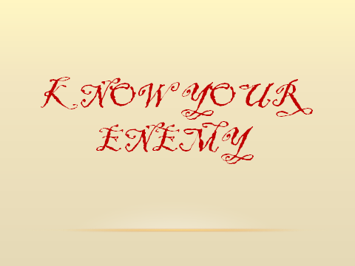

Slide 12
Creation of the Shaytaan
- He is created from a smokeless flame of fire
“Anger is the effect of shaytaan and shaytaan was created from fire. And water extinguishes fire."
- He has an ugly appearance
- He has two horns

Slide 13
The food, drink of jinn
- He eats with his left hand
- The believing Jinn eats any bone that has had the name of Allah pronounced over it.
The Prophet (peace be upon him) said, ”Do not clean yourselves with dung or with bones for they are food for your brothers among the jinn”

Slide 14
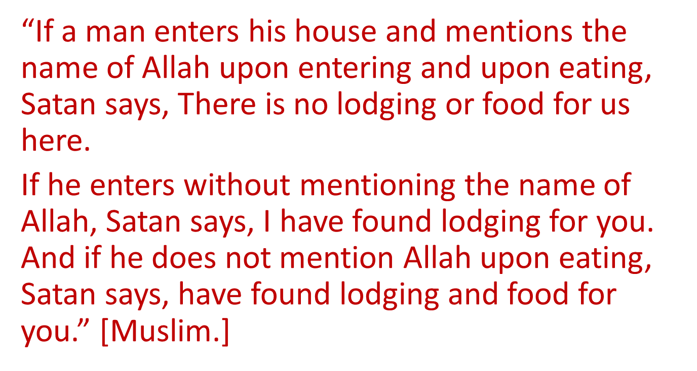
- The Shaytaan eat food that has had not the name of Allah pronounced over it.

Slide 15
The Jinn get married and multiply
“The jinn have children in the same way that the sons of Adam have children, but theirs are more in number”

Slide 16
The shaytaan dies
 كُلُّ مَنْ عَلَيْها فانٍ * وَيَبْقَى وَجْهُ رَبِّكَ ذُو الْجَلالِ والإِكْرَامِ 
Everyone that there in will pass away; There remains but the countenance of your Lord of Might and Glory..

Slide 17
The residence of the jinn and their places
Among the ruins and dilapidated areas
bathrooms, hashish dens, the places of the camels, cemeteries.
- They often gather in the marketplaces
“If you can, do not be the first one to enter the marketplace. And do not be the last to leave it. For they are the places of Satan and therein he raises his banner.” (Muslim).

Slide 18
-The devils may live in the same houses in which people live. One can stop them from entering or repel them from such houses by mentioning Allaah upon entering those houses reciting the Quran, in particular, surah al-Baqarah and the verse of the Throne
- The devils love to sit between the shade and the sunlight. For this reason the Prophet (peace be upon him) forbade the Muslims to sit in such places.

Slide 19
The times that they can be found
the devils spread out and roam about increasingly when the dark first comes, and, therefore, he has advised Muslims to bring in their children during that period of time.
the devils run away from the call to prayer and cannot stand listening to it. And in the month of Ramadhaan they are chained.

Slide 20
Their ability and strength
- They can reach places high up in the space but till a certain limit
Then the jinn listen in and pass on the word to their servants.
They have knowledge in building and other crafts
Their ability to take on other shapes (man – animal – snake …)
Satan is able to flow in the descendants of Adam like blood flows through a vein.
He whisper to human or takes shapes and can talk to him

Slide 21
Their weaknesses and inabilities
 إِنَّ كَيْدَ الشَّيْطَانِ كانَ ضَعِيفًا 
”Verily, the plot of Satan is weak”.
They have no power over righteous slaves
They flees of righteous people like Omar
They were subjugated to prophet Sulaymaan
They cannot produce miracles
They cannot appear in the form of the messenger in the dreams

Slide 22
 وَمَا خَلَقْتُ الْجِنَّ والإِنْسَ إلا لِيَعْبدُونِ 
I created the jinn and humankind only that they worship Me.

Slide 23
They are responsible
- Allaah sent messengers to them
- They are at different levels of good and evil
Ibn Taimiya said, they have in common with humans responsibility for doing what they have been ordered to, and to abstain from what they have been forbidden. On this point, I know of no dispute among the Muslims

Slide 24
THE WEAPONS OF THE BELIEVER
1. Caution and care
2. Sticking to the Book and the sunnah
3. Being busy with the remembrance of Allah
Specially Adhkaar of morning and evening
4. Sticking to the Muslim community
5. Uncovering designs and plans of Shaytaan
6. Differing from Satan
7. Repentance and seeking forgiveness
8. To put an end to the suspicious aspects by which Satan enters into the soul
9- Keep taharah
10- Take care of prayer ( in the mosque for men)
11- Not to listen to music and not to use bells
12- Remove statues pictures from the house

Slide 25
9. Seeking refuge with Allaah
a- upon entering bathrooms
b- during the time of anger
c- during the time of sexual intercourse
d- upon hearing the braying of a donkey
e- before reciting the Quran
f- Upon Entering a Valley or a Strange land
g- for children and family

Slide 26
الاستعاذةI seek refuge in Allah from the outcast Satan
the Prophet said, The people did not make invocation like these two: Say, I seek refuge in the
Lord of Daybreak,. and Say, .I seek refuge in the Lord of Mankind...(al-Nasaai)
It is like a sword that is in the hands of a warrior. If his arm is strong, he is able to penetrate and kill his enemy. If his arm is weak, he may leave no mark at all on his opponent, even if it is a very sharp sword

Slide 27
The great understanding
One of the early scholars said to his student, What would you do if Satan entices you to sin?.
I would struggle against him.
And if he returns ? I would struggle against him.
And if he returns again? I would struggle against him.
This can take forever. What if you are passing by some sheep and their watchdog starts barking at you, preventing you from passing, what would your action be? I would wear it down by struggle and repel it.
This is a lengthy process. If you go instead to the owner of the sheep, he will be able to make the dog desist...

Slide 28
Hasad
 وَمِن شَرِّ حَاسِدٍ إِذا حَسَدَ 
“And from the evil of the envier when he envies”
- The envier wishes that the blessing be taken away from the one whom he envies, whether the blessing comes to him or not.
- Envy was described as a sickness by the Prophet, sallallahu `alaihi wa sallam.
- “Envy eats away at good deeds, just as fire eats away at firewood.” [Ibn Majah]
- Envy is displeasure with Allah's decree and His granting blessings upon others.
Faith and envy do not go together in the heart of a servant." [Ibn Hibban]
- The Prophet, sallallahu `alahi wa sallam, described envy as a shearer of the religion.
- No one attains true belief until one loves for one’s brother what one loves for oneself.
- The greatest harm from envy comes to the envier, who with one’s displeasure with Allah’s decree attains a great loss to oneself.

Slide 29
The evil eye
 وإن يَكادُ الَّذِينَ كَفَرُوا لَيُزْلِقُونَكَ بِأَبْصَارِهِم لَمَّا سَمِعُوا الذِّكْرَ 
“And verily, those who disbelieve would almost make you slip with their eyes (through hatred) when they hear the Reminder”
Ibn ‘Abbaas, Mujaahid and others said: “Make you slip with their eyes” means, they will put the evil eye on you. This Verse is evidence that the effect and impact of the evil eye is something real and happens by Allaah’s will.
“Most of those who die among my ummah die because of the will and decree of Allaah, and then because of the evil eye.”
“The evil eye is real and if anything were to overtake the divine decree, it would be the evil eye. When you are asked to take a bath (to provide a cure) from the influence of the evil eye, you should take a bath.” (Muslim).

Slide 30
Types of evil eye
3Ain is like an arrow that comes out from a person to the other,
It can be of two types:
1- From a loving person : “if someone sees from his brother or from himself or from his wealth something he likes, let him ask Allaah to bless because ain is a fact”
Story of Sahl Ibn Haneef
…There Sahl ibn Haneef did ghusl, and he was a handsome white-skinned man with beautiful skin. ‘Aamir ibn Rabee’ah, looked at him whilst he was doing ghusl and said: “I have never seen such beautiful skin as this, not even the skin of a virgin,” and Sahl fell to the ground. They went to Messenger of Allaah (peace and blessings of Allaah be upon him) came and said, “O Messenger of Allaah, can you do anything for Sahl, because by Allaah he cannot raise his head.” He said, “Do you accuse anyone with regard to him?” They said, “ ‘Aamir ibn Rabee’ah looked at him.” So the Messenger of Allaah (peace and blessings of Allaah be upon him) called ‘Aamir and rebuked him strongly. He said, “Why would one of you kill his brother? If you see something that you like, then pray for blessing for him.”

Slide 31
2- Envier person: he might feel it or not
 وإن يَكادُ الَّذِينَ كَفَرُوا لَيُزْلِقُونَكَ بِأَبْصَارِهِم لَمَّا سَمِعُوا الذِّكْرَ 
“And verily, those who disbelieve would almost make you slip with their eyes (through hatred) when they hear the Reminder (the Qur’aan)
(they asked a man to harm the messenger with his eye)

Slide 32
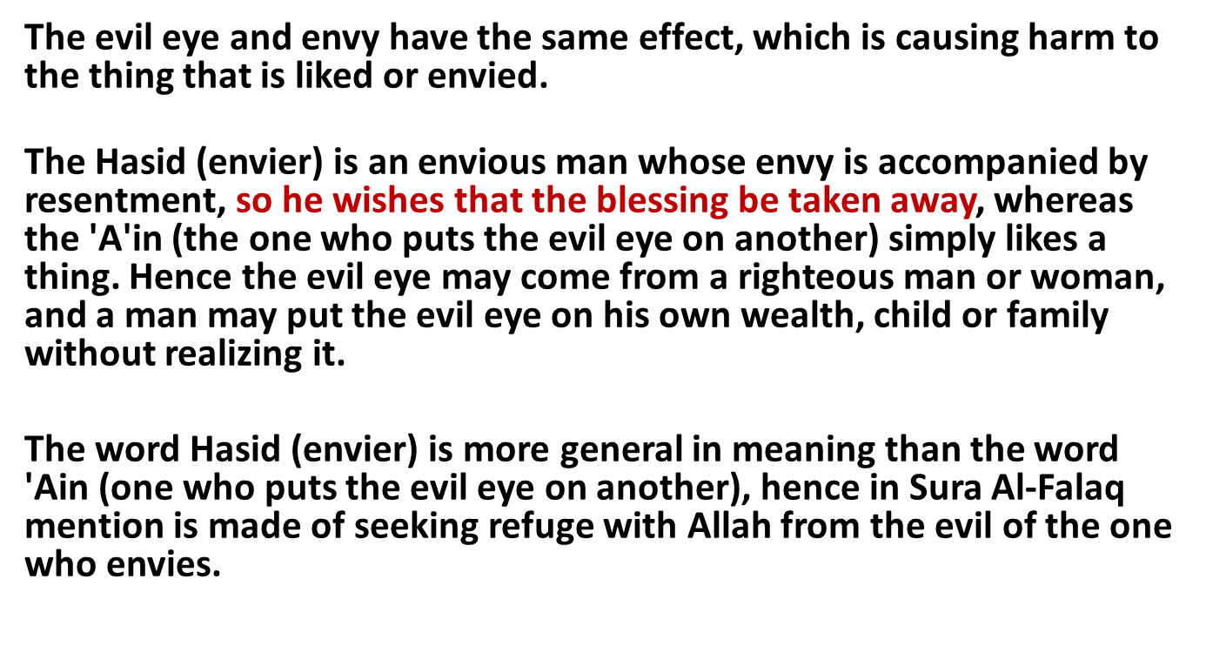
Difference between Hasad and evil eye
The envy includes the evil eye but not the opposite, and seeking refuge from the envier includes seeking refuge from the evil eye.

Slide 33
Jinn and evil eye
- The jinn can harm human with their eyes:
Abu Sa`id Al-Khudri said, "The Messenger of Allah used to seek refuge from the evil eye of the Jinns and the evil eye of humans. Then when the Mu`awwidhatan were revealed, he used them (for seeking protection) and abandoned everything else. (At-Tirmidhi, and An-Nasa'i)
- How is evil eye harming?
1- by it self
2- by the jinn
Ibn Al-Qayyim said: ” The origin of the evil eye is liking something, then the evil soul follows it, pursues it and seeks to do harm to it, seeking help to apply its poison by looking at the object”
Sheikh Ibn Jibreen said:” The evil eye is followed by shaytaan of jinn who might cause the harm with the qadar of Allaah”

Slide 34
Waswasah (obsession)
These whispers are among the plots of the devil to spoil the person's religion and make his life miserable
- In faith
Who created you? Who created Allaah? Why did Allaah …
- In wudoo’
Repeating Wudu again and again due to doubts is the result of falling into satanic whispers.
- In Salat
He doesn’t know how many rak3a did he pray
Repeating the niyyah …
- In everyday matters
- Can be of the main symptoms of sihr or evil eye

Slide 35
The Cure of The Qur’aan and Sunnah
From Sihr
From Evil eye
From Obssession

Slide 36
Symptoms of evil eye
Joint problems; laziness; spots; anti-social behavior against their own relatives; turning away with aversion against anybody; forgetfulness; anxiety; heavy shoulders; contrast of one’s body temperature; etc.
And the worst of it is when it is associated with devil’s touch.
Symptoms of evil eye during Ruqiah (Recitation)
1. Yawning associated with tears. Yawning at other times is not proof.
2. They can fall unconscious (sleep) little while
3. The patient might start to sweat, particularly the head
4. They might wish to cry
5. Their limbs get colder than usual
6. Their hearts might beat harder than usual
7. Their body might experience a strange heat

Slide 37
Cure from evil eye
1-الاستعاذة from it
 وَمِن شَرِّ حَاسِدٍ إِذا حَسَدَ 
The Messenger of Allaah said: I seek refuge in the perfect words of Allaah, from every devil and every poisonous reptile, and from every bad eye).”(al-Bukhaari
2- Adhkaar for morning and evening, and the adhkaar for going to sleep, and others
3- Ruqya
Asma’ bint ‘Umays said: “O Messenger of Allaah, the children of Ja’far have been afflicted by the evil eye, shall we recite ruqyah for them?” He said, “Yes, for if anything were to overtake the divine decree it would be the evil eye.”

Slide 38
4- Wudoo’ or special wash if we know who cast the evil eye
In the story of Sahl :
Then he said to him, “Wash yourself for him.” So he washed his face, hands, forearms, knees and the sides of his feet, and inside his izaar (lower garment) in the vessel. Then that water was poured over him, and a man poured it over his head and back from behind. He did that to him, then Sahl got up and joined the people and there was nothing wrong with him
‘Aa’ishah (may Allaah be pleased with her) said: The person who had put the evil eye on another would be ordered to do wudoo’, then the person who had been afflicted would wash himself (with that water). Saheeh Abi Dawood.

Slide 39
Cure from Waswaasah
1- الاستعاذة from shaytaan
2- Knowledge of Deen you need to push the idea:
- In faith
“The Devil will come to one of you and ask: who created such and such? Till he asks him who created your Creator? If he reaches this question one should seek refuge with the Lord and should stop”.
“ …. Let him say I believe in Allaah and his messenger”
- In wudoo’
- Don’t waste water Al-Bukhari said, "Scholars do not approve of using water beyond what the Prophet would use for wudu'."
- Ibn al-Mubarak, "If one is uncertain about his condition of purity, he does not need to perform a new ablution.“
Did Sahaba repeat wudhu the same way? Are you being more careful in the matters of deen than the Sahabah?

Slide 40
In salaat
- "If one of you finds a disturbance in his abdomen and is not certain if he has released any gas or not, he should not leave the mosque unless he hears its sound or smells its scent." (Muslim)
When doubts attack you shortly after performing Salah (prayer) or Wudu ' (ablution), then turn away from and pay no attention to them. Be sure that both your Salah (prayer) and Wudu ' (ablution) are valid.
- “Oh Rasūlullah! The Shaytān comes between me and my prayers and my recitation, confusing me therein.” Rasūlullah (sallallahu ‘alayhi wa sallam) said: “That is a shaytān that is called khanzab. If he affects you seek refuge in Allah from him and spit drily to your left three times.” The companion said, I did that and Allāh took him away from me.

Slide 41
3- Ask the devil to get out
“When the Messenger of Allah appointed me as governor of at-Taa’if, something began to appear to me in my salaah so that I wouldn’t know how many rak ‘aahs I had prayed. When I noticed that, I traveled to the Messenger of Allah. He said, ‘Ibn Abee al-‘Aas?’ I said ‘Yes, O Messenger of Allah.’ He said, ‘What brings you here?’ I said, ‘O Messenger of Allah, something appears to me in my salaah, so that I don’t know how many rak ‘aahs I have prayed.’ He said, ‘Come close.’ So I came close to him and sat on the soles of my feet. He struck my chest with his hand, blew into my mouth and said, ‘Get out, Enemy of Allah!’ He did that three times, then said, ‘Resume your duty.’ After that, I swear I was never confused ( in my salaah)
4- Not to hesitate .Shaytaan should lose hope in deviating you
5- Make your self busy
6- Ruqyah
7- Lot of dhikr, long prayer, memorize and listen to Qur’aan

Slide 42
Symptoms of Sihr
1. Most cases of black magic are associated with the symptoms of devil’s touch
2. Sudden attitude change i.e. from love to hatred, from being healthy to illness, from joy to sadness, etc.
3. Very bad tempered and quick to react
4. Their state worsens or their symptoms change when the Qur’aan is recited upon them or after that
5. Those suffering from magic feel like being urged to say something or to do an action without their will and most of the time they regret their behaviour.

Slide 43
6. Pain in the stomach - Constipation
7. Pain in the low back and left arm
8. Their eyes appear to be remarkably shining, red and they look up and down.
9. A very putrid smell comes from their mouth or their skin or their stomach even if they wash themselves they cannot get rid of it

Slide 44
10. They feel bad taste for Zamzam water
11- Loosing weight – loss of hair
12- Jinn attack - Erotic dreams ( snakes – black creature- bad pictures…)
13- Mental distraction (mind always absent)

Slide 45
Symptoms during ruqyah
1. Crying when hearing the verses wherein magic is mentioned
2. To fall asleep
3. Painful stomach
4. The patient looks at the raqui “ The one who recites” ironically
5. The patient might laugh without his will
6. some patient shiver or shake

Slide 46
Cure from Sihr
We try to find the sihr
The patient will have a vision which is a bounty from Allaah similarly to the Prophet who had a vision in regards to the sihr that was worked on his hair.
2. When the magic is associated with devil’s touch then the jinn might indicate where the magic is hidden.
3. The patient could have a feeling “ basseerah ” or a guess to where the black magic is.
If we find it:
We read آية الكرسي andإخلاص and المعوذتان
We remove the knots
If Sihr is written we put in water with Qur’aan read on to remove the writing then put it under the sand
To pour water with Qur’aan read on over the floor

Slide 47
Cure of Possession of jinn
1- Cursing him:
He said, "That was the enemy of Allaah, Iblees. He came with a flame of fire and tried to throw it in my face. I said, "I seek refuge in Allah from you" three times and said "I curse you with the complete curse of Allaah“
2- Explaining to jinn the sin they do

Slide 48
3- Commanding the jinn to get out
Ya’la ibn Murrah that he said, I went with the Prophet on a journey. When we had covered a little distance we passed by a woman who was sitting down with a child. She said, ‘O’ Messenger of Allah , this child has been inflicted with a calamity and we have been inflicted because of him. I cannot count the amount of fits he has during a single day.’
The Prophet said, ‘Bring him to me.’ The woman lifted the child towards him and placed the child between the Prophet and the saddle.
They lifted him up and the Holy Prophet spat at him three times.
Then he said, ‘In the name of Allah. I am his servant. Come out O’ enemy of Allah.’
- Imaam Ahmad commanded the jinn to leave the body and he did.

Slide 49
4- beating the jinn
If the person lose conscious Raqui might beat him, in that case the he does not feel any pain, all pain is on jinn
5- Utilization of laxatives, vomiting:
To use any herb that is laxative mixed with some water that was read upon during ruqiah.
6 – Cupping
7 - Always keep woodhoo as it helps a lot.
8- Eating Ajwa dates
- “He who eats seven Ajwa dates every morning, will not be affected by poison or magic on the day he eats them.” al-Bukhari.

Slide 50
9- Writing some Qur'anic verses on a piece of paper and putting this paper in some water before giving that water to a sick person to drink
Mujahid said: 'The Qur'an can be written with saffron or ink then washed and given to a sick person to drink it'.
Ibn Abbas ordered that some Qur'an be written and washed with some water and used as a treatment for a woman who had difficulties delivering
"Zam Zam water is for what it is drunk for".

Slide 51
10- Reading and listening to Ruqiah
Ruqiah is performing supplications, reciting Qur’aan, or by any good words and blowing in order to seek Allaah’s assistance and refuge in Him from any pain or sickness.
“Present your incantations to me. There is no harm in incantations as long as there is no shirk in them”
“whoever is able to assist his brother should do so”
“ She is affected by the evil eye. Seek ruqyah for her”

Slide 52
Examples of ruqyah
1- Al- Fatihah
It is an excellent Ruqya as in the story of Abu Saeed when he read fatihah (7 times) to cure the leader of a tribe and Allaah cured him.
Then the prophet said:” How did you know it was a ruqia?”
Ibn Al Qayyyem used to read it a lot on Zamzam water and drink when he was sick

Slide 53
سورة البقرة
“Do not make your houses into graves, for the Shaytaan flees from a house in which Soorat al-Baqarah is recited.”
"Learn Surat Al-Baqarah, because in learning it there is blessing, in ignoring it there is sorrow, and the sorceresses cannot memorize it (or can not harm the person who reads it)."

Slide 54
آية الكرسي
"When you lie down in your bed, recite ayat Al-Kursi, اللهُ لا إِلهَ إِلا هُوَ الْحَيُّ الْقَيُّومُ Allah! La ilaha illa Huwa (none has the right to be worshipped but He), the Ever Living, the One Who sustains and protects all that exists… [al-Baraqah 2:255] until the end of the ayah, then you will have a protector from Allah and no shaytan (devil) will come near you until morning comes….
Ibn Taimia said: "The numerous people who have experienced these events all confirm the amazing effectiveness of this verse in warding off jinn and breaking their spells." Al-Bukhari

Slide 55
المعوذتان
The Messenger of Allah صلى الله عليه وسلم used to seek refuge in Allah from jinn and the evil eye in men till the Mu'awwidhatan came down, after which he made use of them and abandoned everything else. Tirmidhi

Slide 56
: "لَا إِلَهَ إِلَّا اللهُ وَحْدَهُ لَا شَرِيكَ لَهُ، لَهُ الْمُلْكُ وَلَهُ الْحَمْدُ، وَهُوَ عَلَى كُلِّ شَيْء ٍقَدِيرٌ“ 100 times
“It will be a sanctuary from Shaytaan for him on that day until he reaches the evening”.

Slide 57
Conditions in Ruqyah
Must Be with Allah's Words, Names, or Attributes
As we will see below, all forms of ruqya reported in the Sunnah satisfy this condition. They either consist of specific portions of the Qur’an, such as al-Fatiha or Ayat ul-Kursiy, or contain a praise of Allah ('Azza wa Jalla) and an invocation of His help and protection.
2. Must Be with Clearly Understood Words
This is an important condition that must be satisfied in order to eliminate any magic factors from the ruqyah.
3. Believing That the True Benefit Is from Allah ('Azza wa Jalla)
The cure is from Allah and not from the one performing the ruqya, no matter how pious he seems- if he claims to be able to cure people and you believe him- then you have committed shirk- exactly what the shaytan and the magician want of you.
4- To be seeked of pious people
5- Women should go with Mahram

Slide 58
Conditions of a person who treats with Ruqyah:
1) He must have the right belief in Allah (Based on Qur’aan, Sunnah, and keep away form Shirk, etc)
2) He must have sincerity in worshipping Allah and have a good intention in treating people
3) He must be firm in his obedience to Allah, and keep away form all that is forbidden
4) He must keep far away from all unlawful places and situations that can lead to what is forbidden, for example isolating himself with a female, etc.
5) He must guard the affairs of his patients and protect their secrets.
6) he must propagate the religion of Allah. Give the Patient advice and admonitions on the rights of Allah with regards to His commandments and prohibitions.
7) He should have knowledge about the affairs of the patient and sicknesses
8) He should have knowledge about the reality of Jinn (so as not to have them harm or threaten him while curing the patient)
English video m 31

Slide 59
Trust Allaah and ask Him for cure
Allaah سبحانه وتعالى said:
“We surely will give aid to our Prophets and those who believed in this world and on the day when the witnesses will stand forth. The Day when the oppressors’ excuses will be of no benefit to them, to them is the curse, and to them is the worst of dwellings.” Ghafir 50-51

